Slide 1
Python-based Tool for Automatic Transit Coding using GTFS for Cube Models
Diego Galdino, MSc.

Slide 2
Summary
Methodology
Cube App Interface
Inputs
Outputs
Conclusions and Recommendations

Slide 3
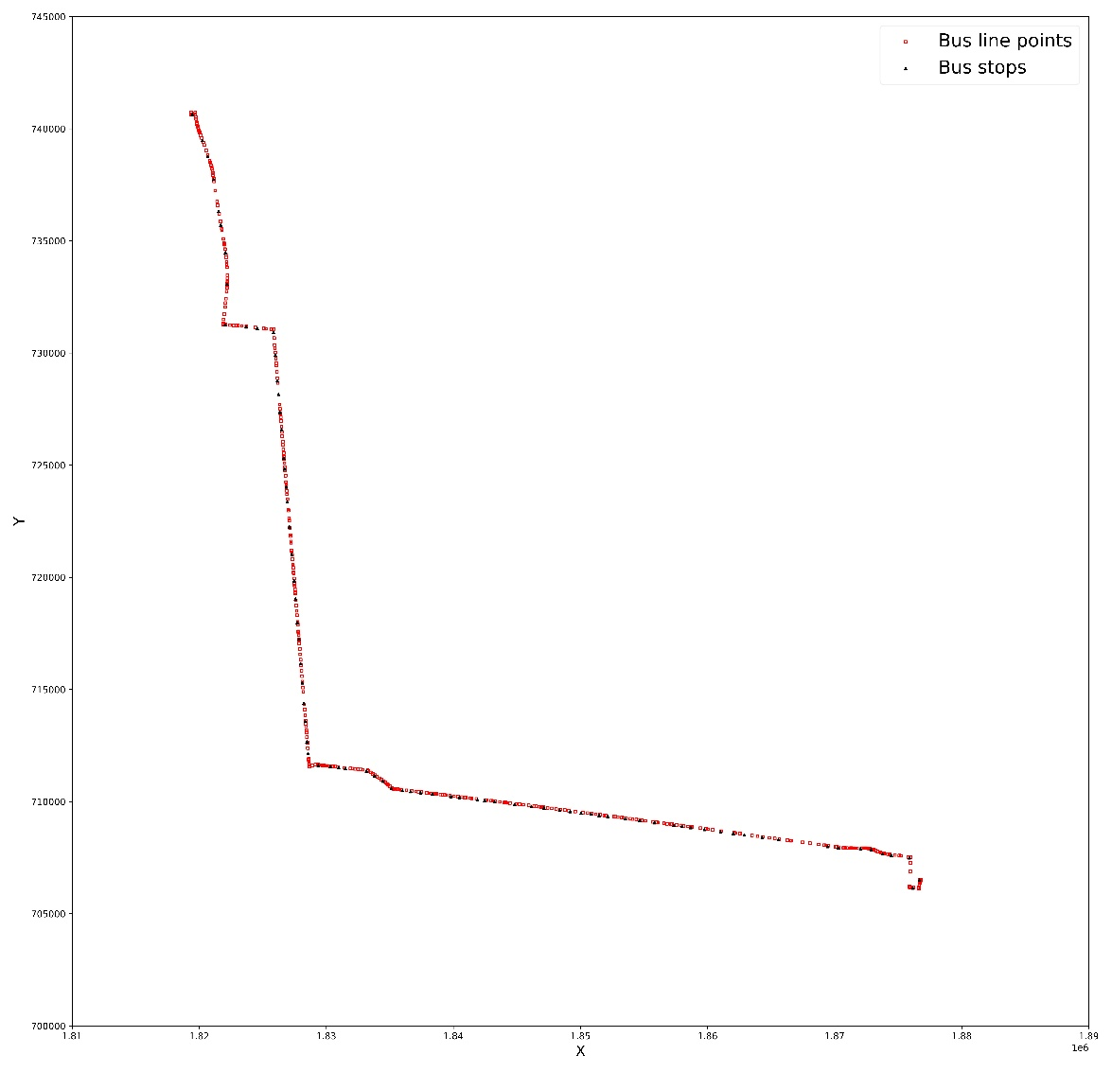
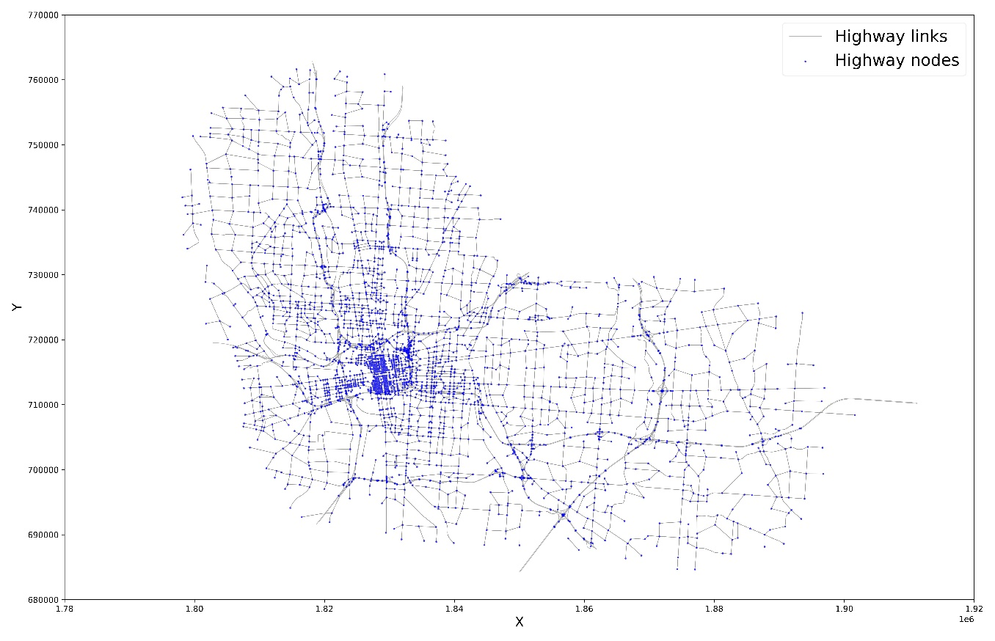
Methodology
Figure 1. Highway network.
Figure 2. GTFS spatial data.

Slide 4
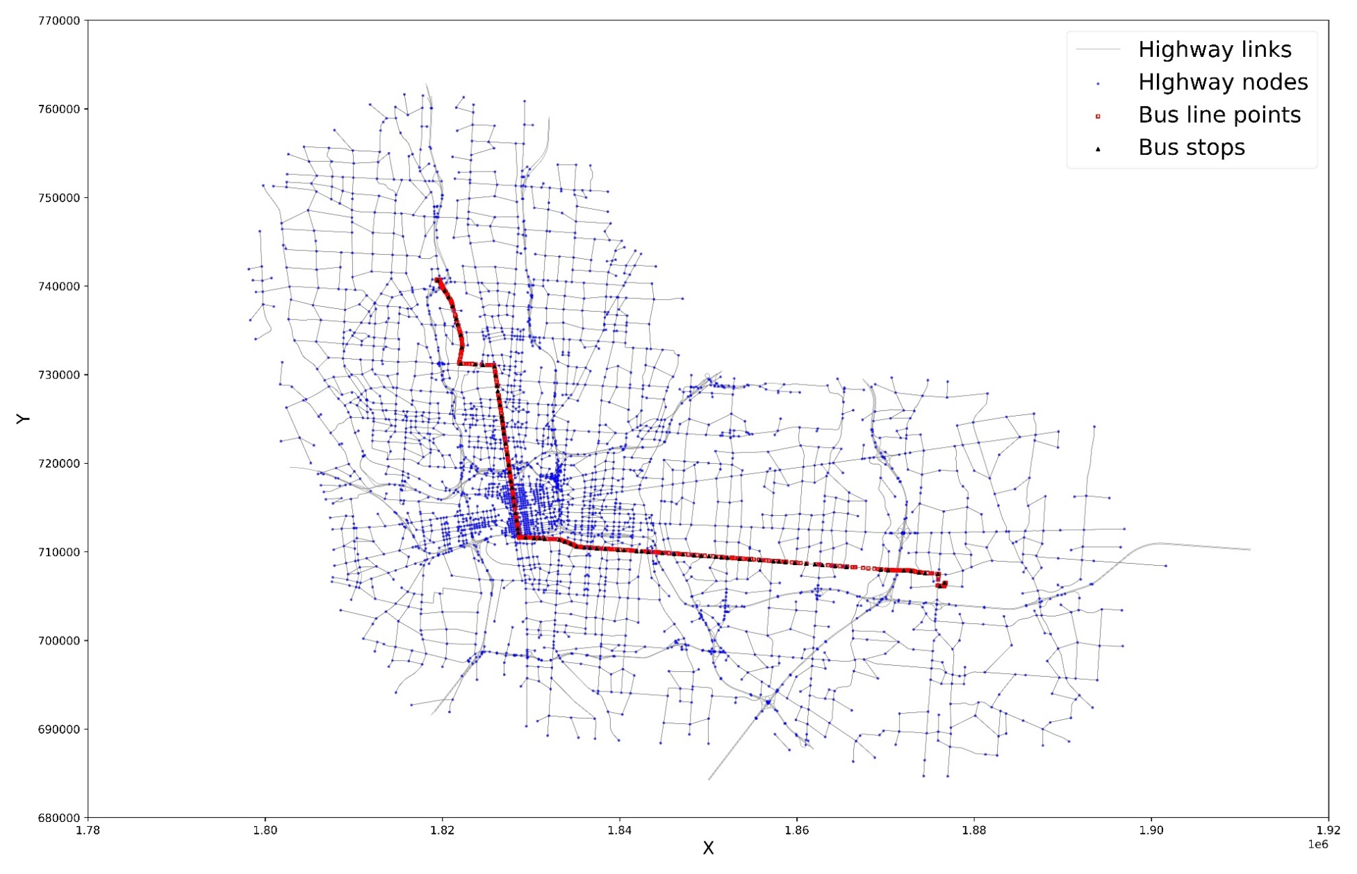
Methodology
Figure 3. Highway network with the GTFS spatial data.

Slide 5
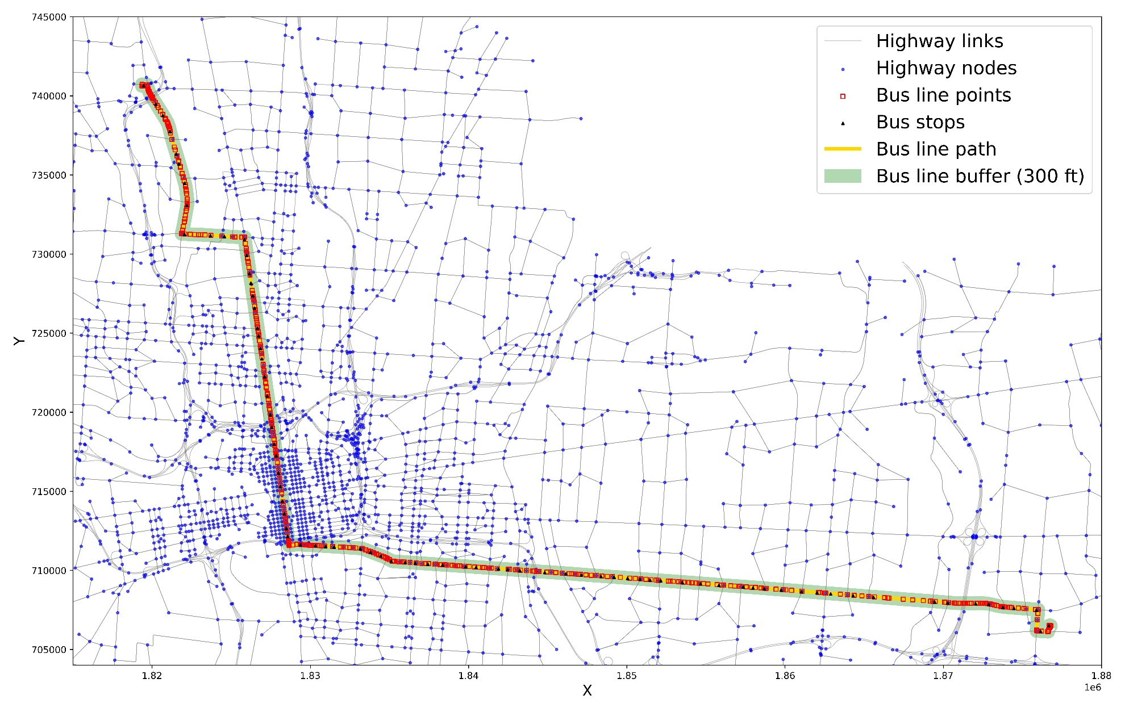
Methodology
Figure 4. Highway network, GTFS spatial data, and the bus line buffer.

Slide 6
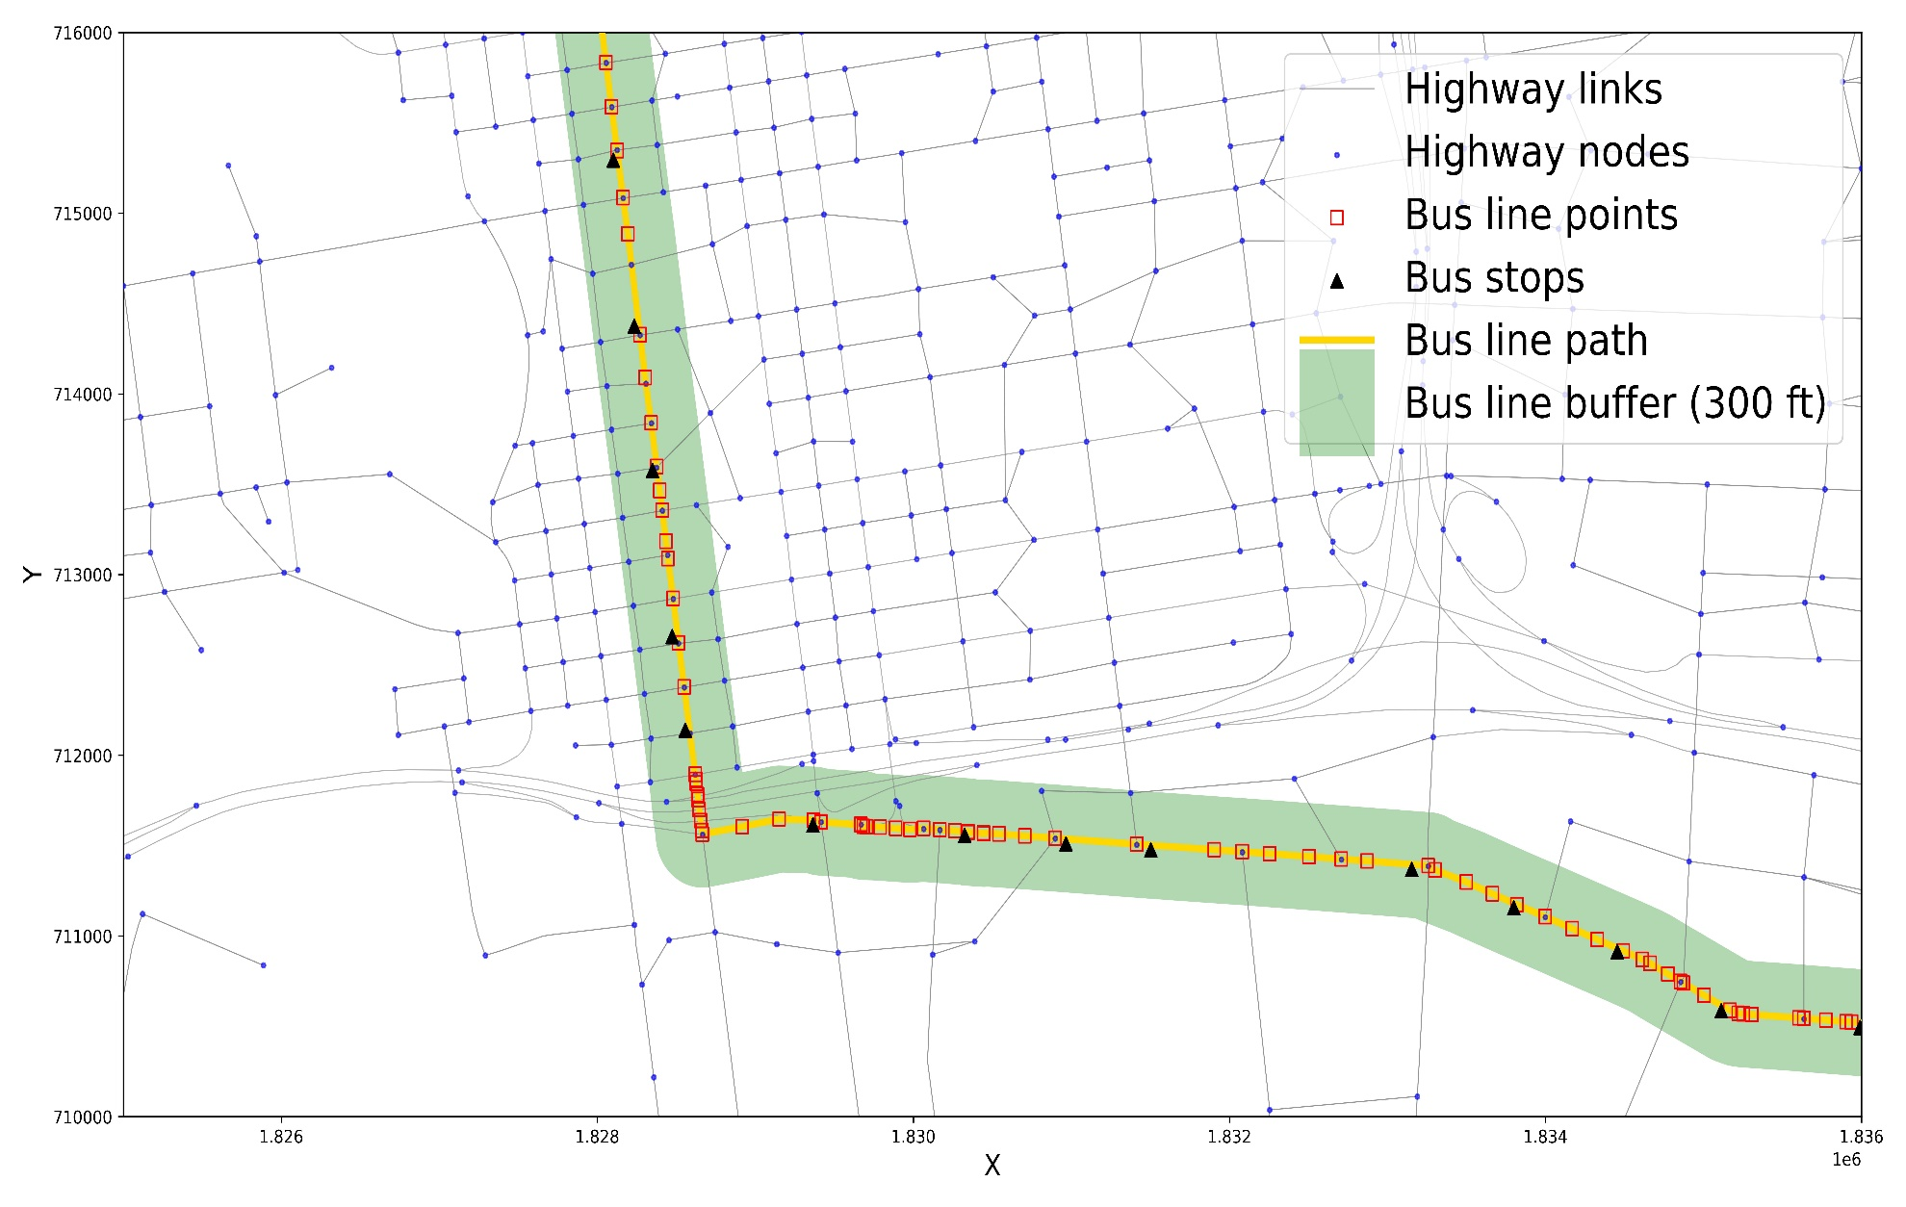
Methodology
Figure 5. Bus line spatial data with more details.

Slide 7
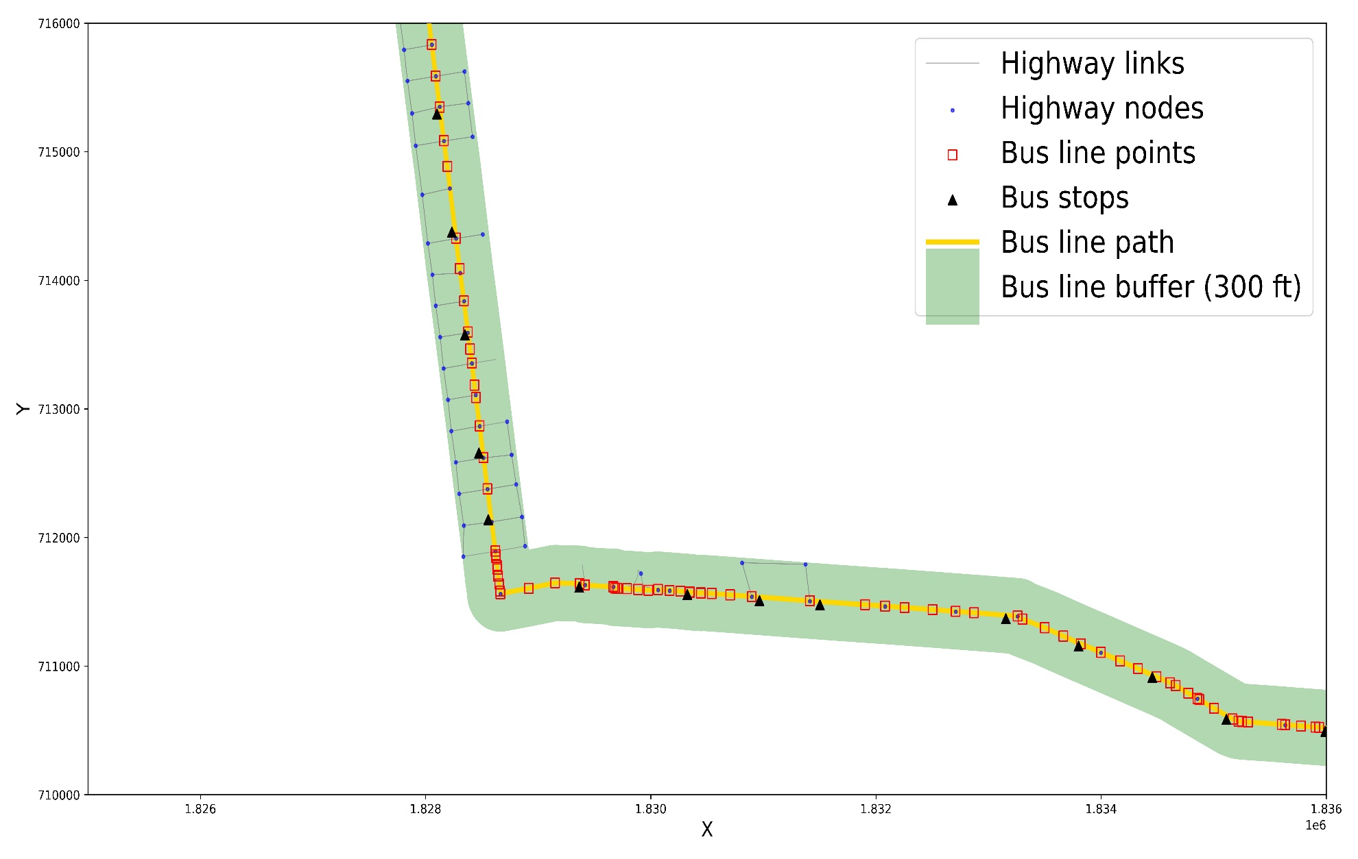
Methodology
Figure 6. Only the available spatial data found within the bus line buffer.

Slide 8
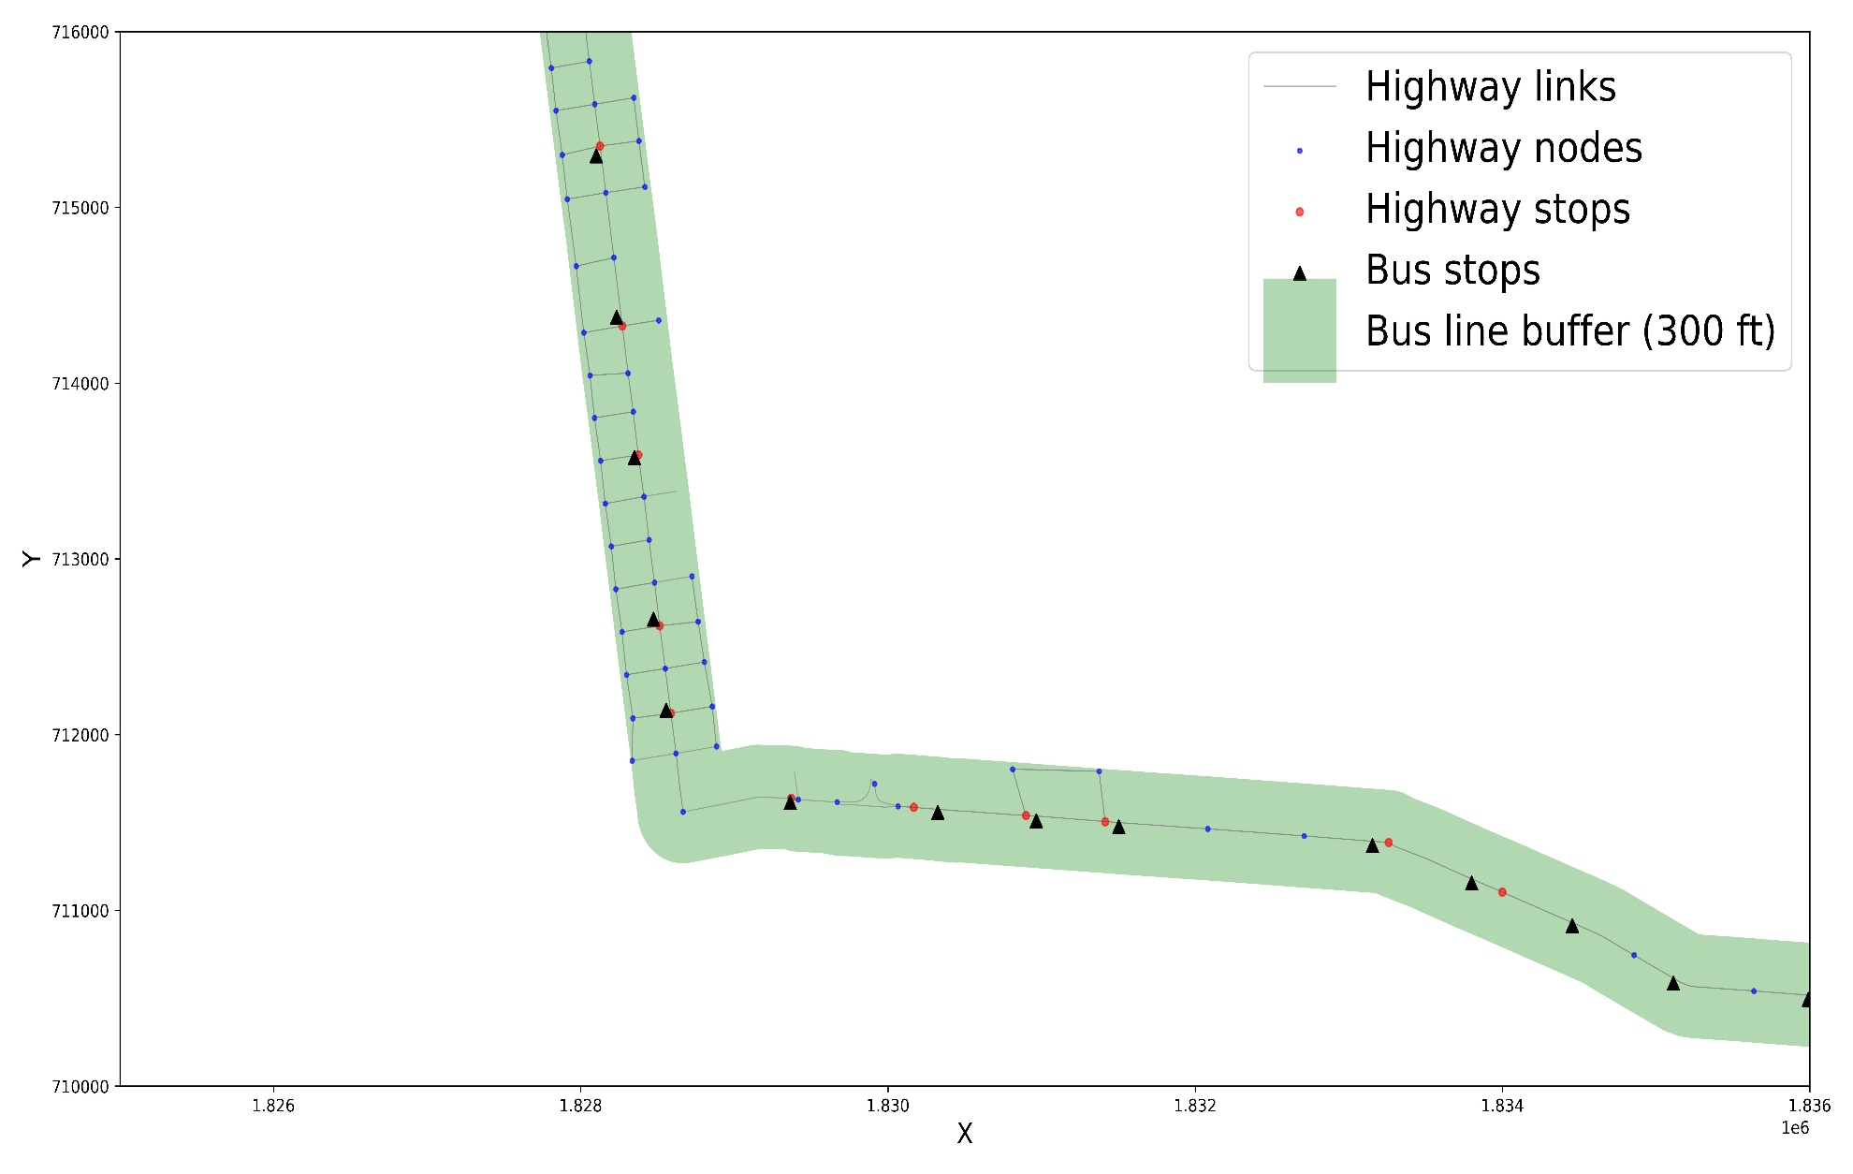
Methodology
Figure 7. Closest highway nodes to bus stops according to a distance limit.

Slide 9
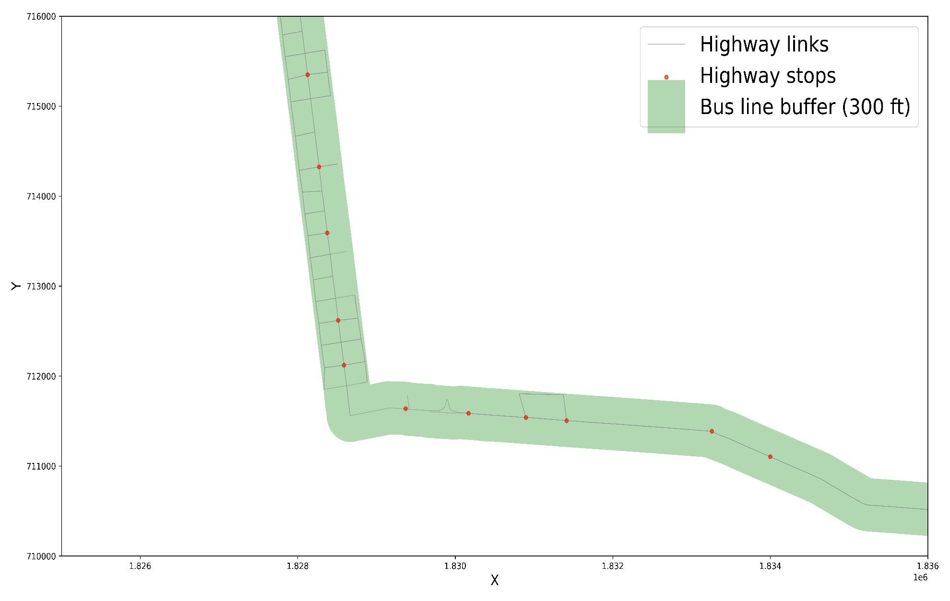
Methodology
Figure 8. Highway stops and links.

Slide 10

Methodology
Figure 9. Bus line path found by connecting the highway stops in sequence.

Slide 11
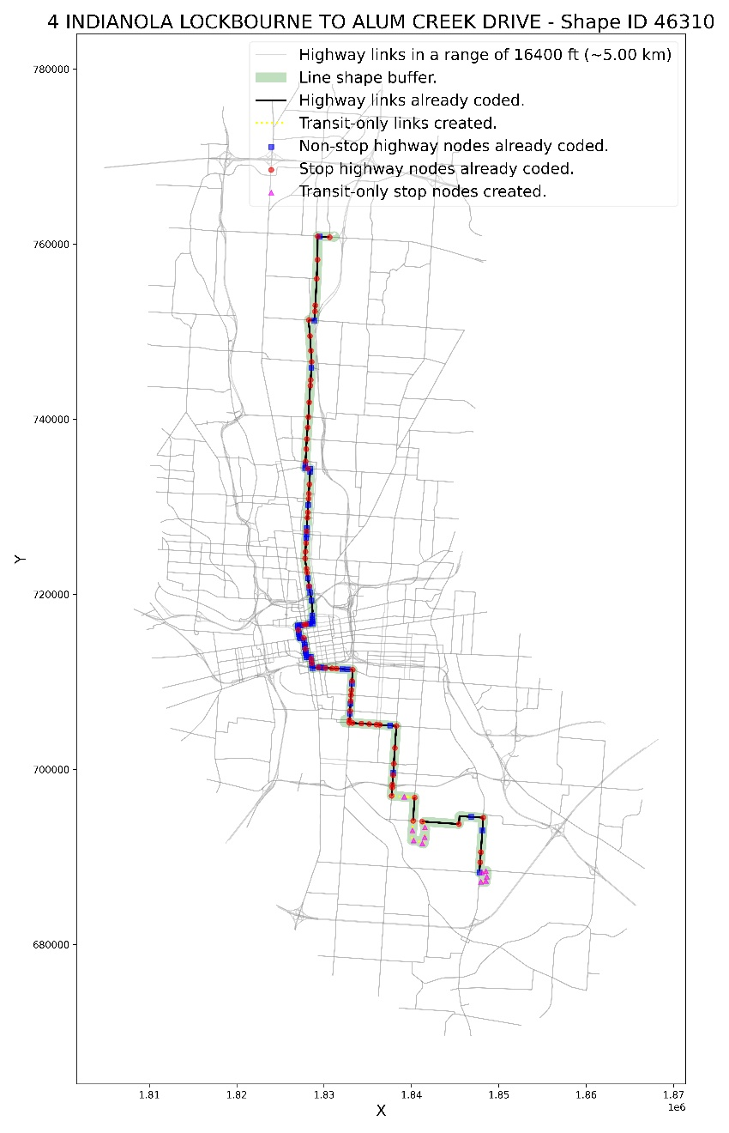
Methodology
Figure 10. Transit-only nodes and links created to fill in the gaps of the network.

Slide 12
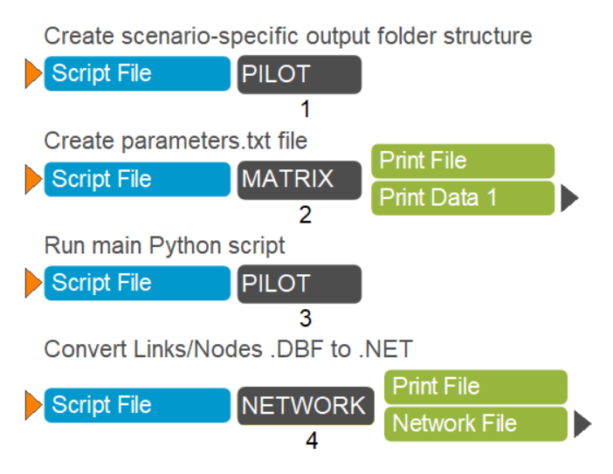
Cube App
Figure 11. Cube App with 4 processes.

Slide 13
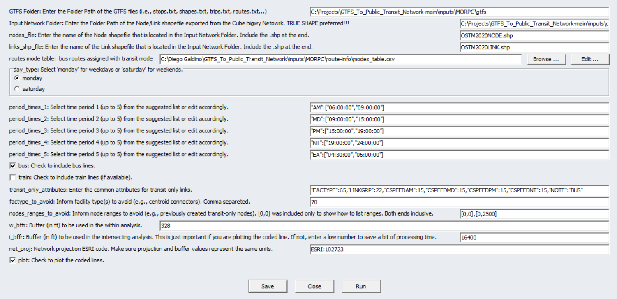
Cube App
Figure 12. MORPC scenario in the Cube app.

Slide 14
Inputs
Network (True shape)
Open the .NET file in Cube, activate the True Shape, and export the network as Link and Node Shape Files (*.shp)
General Transit Feed Specification (GTFS)
“data specification that allows public transit agencies to publish their transit data in a format that can be consumed by a wide variety of software applications” (GTFS.ORG, 2023)
All required information: stops, shapes, trips, routes, stop times, calendar, etc.
https://database.mobilitydata.org (download their CSV spreadsheet)
Route Mode Table
CSV spreadsheet with columns ROUTE_ID, ROUTE_NO, LONG_NAME, and MODE.
ROUTE_ID, ROUTE_NO, LONG_NAME: Take this info from GTFS “routes.txt”.
MODE: Your own definition. This will be used in .LIN.

Slide 15
Outputs
Network
The Python script exports Link and Node shapefiles. The Cube app combine them back to .NET.
The new network contains the transit-only links and nodes.
Transit-only
Transit-only links and nodes are exported as CSV spreadsheets.
Line file (.LIN) with transit lines basic information (name, mode, headways, oneway, allstops, vehicletype, circular) and sequence of nodes.
Images
The tool can export images of the final routes like the ones in the next slides.

Slide 16
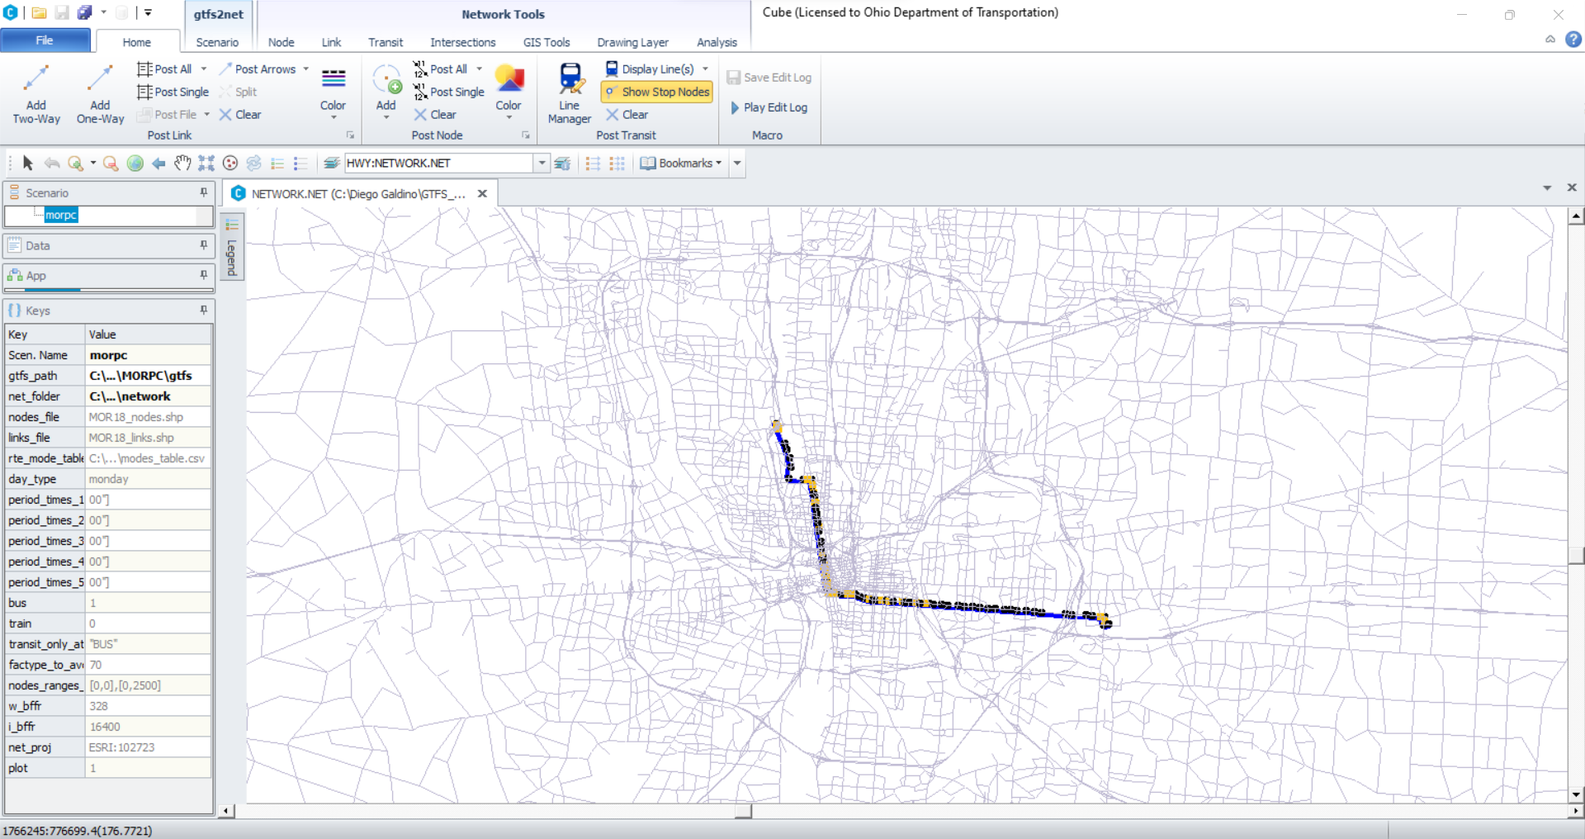
Outputs
Figure 13. MORPC network with lines loaded and route 1 selected.

Slide 17
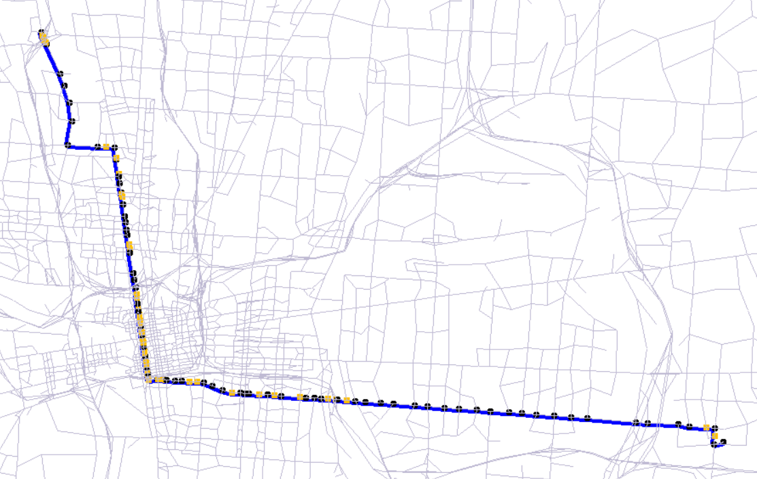
Outputs
Figure 14. MORPC network with lines loaded and route 1 selected and in zoom.

Slide 18
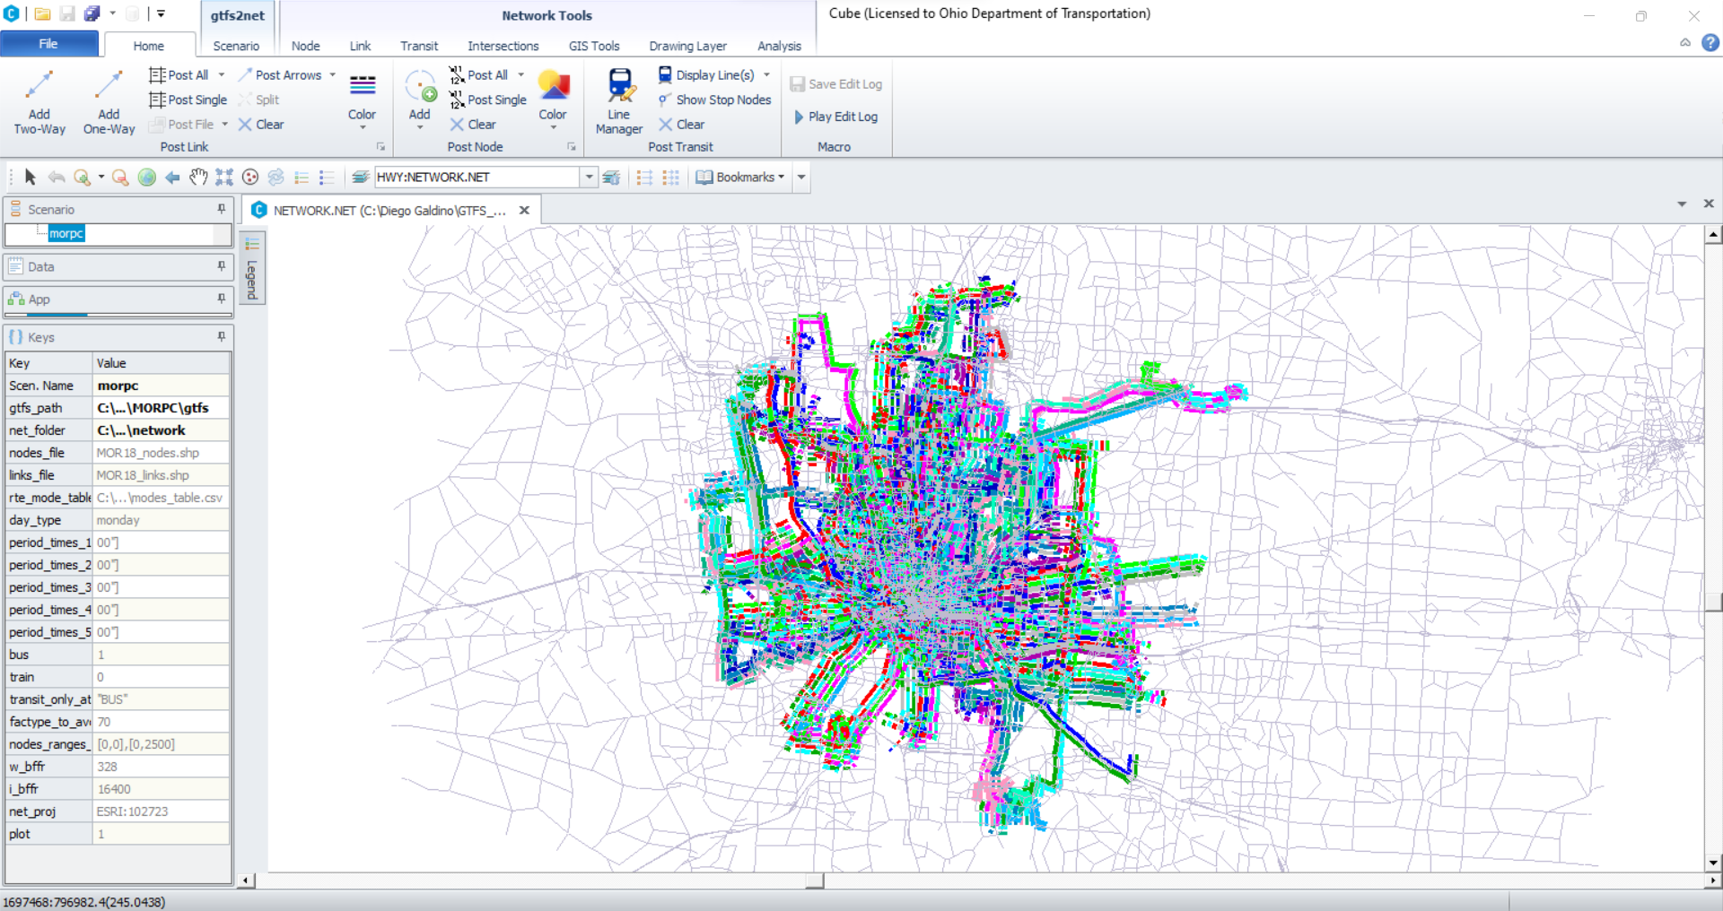
Outputs
Figure 15. MORPC network with lines loaded and all routes selected.

Slide 19
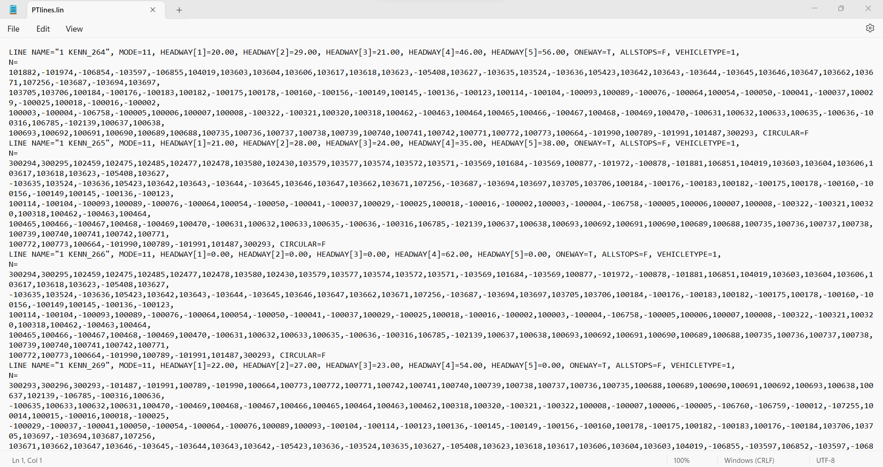
Outputs
Figure 16. Line file produced by the tool.

Slide 20
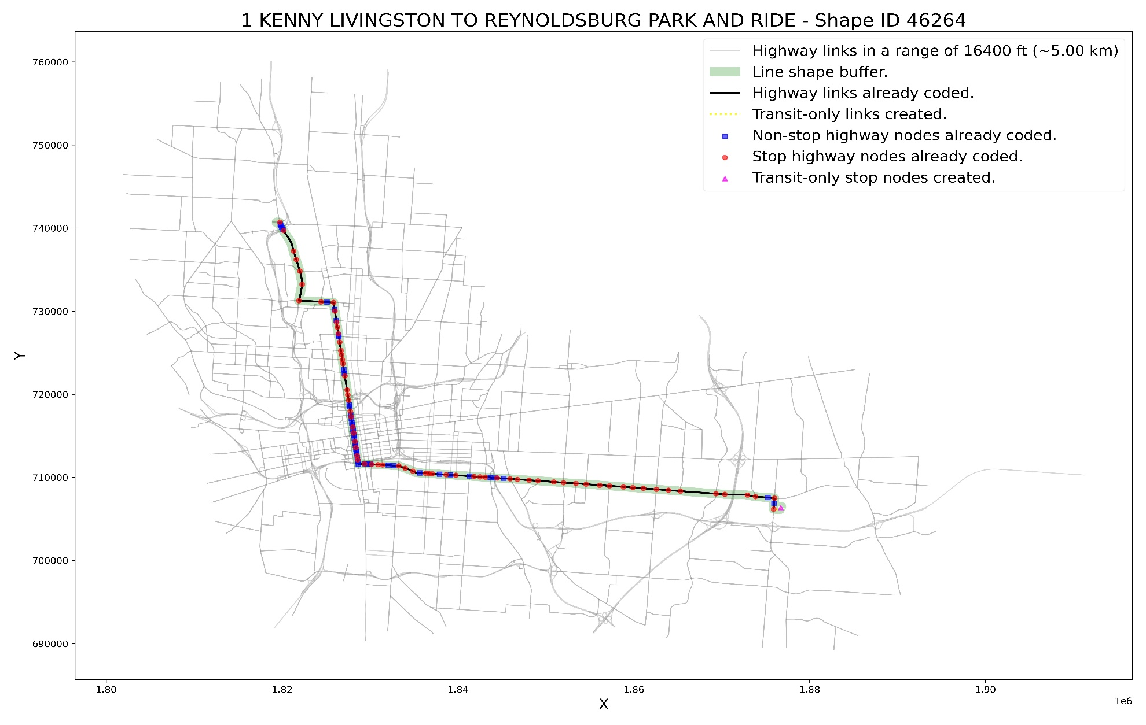
Outputs
Figure 17. COTA line 1 with MORPC network.

Slide 21
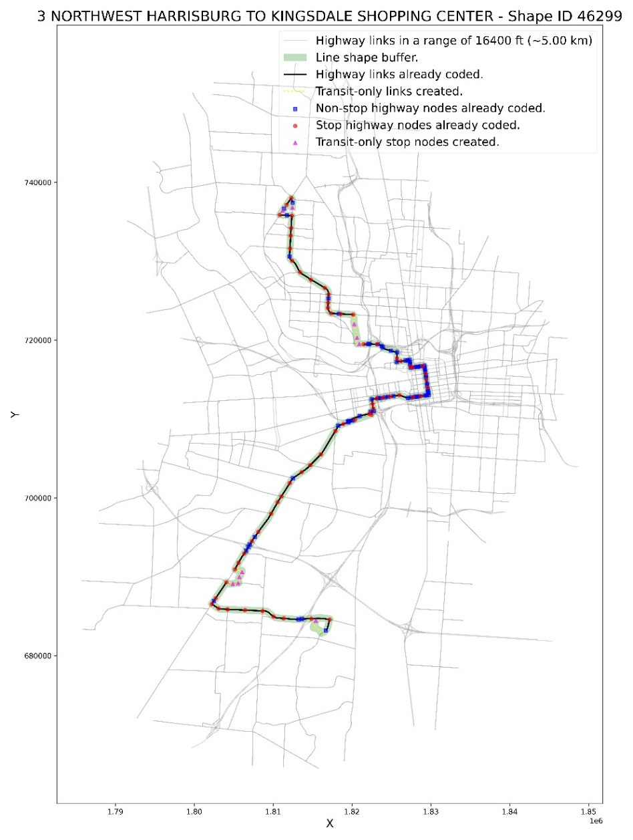
Outputs
Figure 18. COTA line 3 with MORPC network.
Figure 19. COTA line 4 with MORPC network.

Slide 22
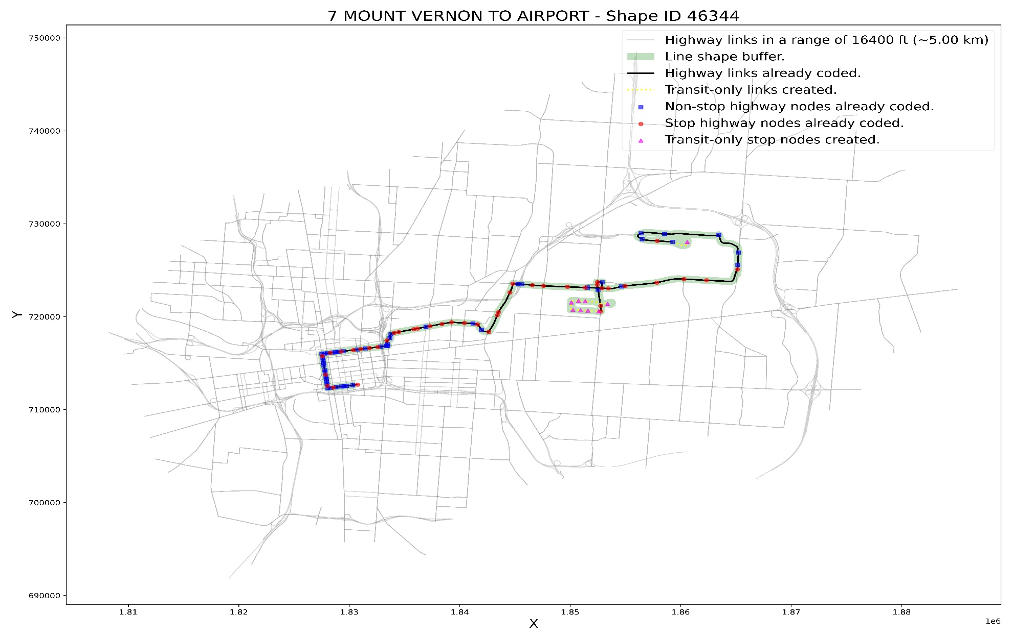
Outputs
Figure 20. COTA line 7 with MORPC network.

Slide 23
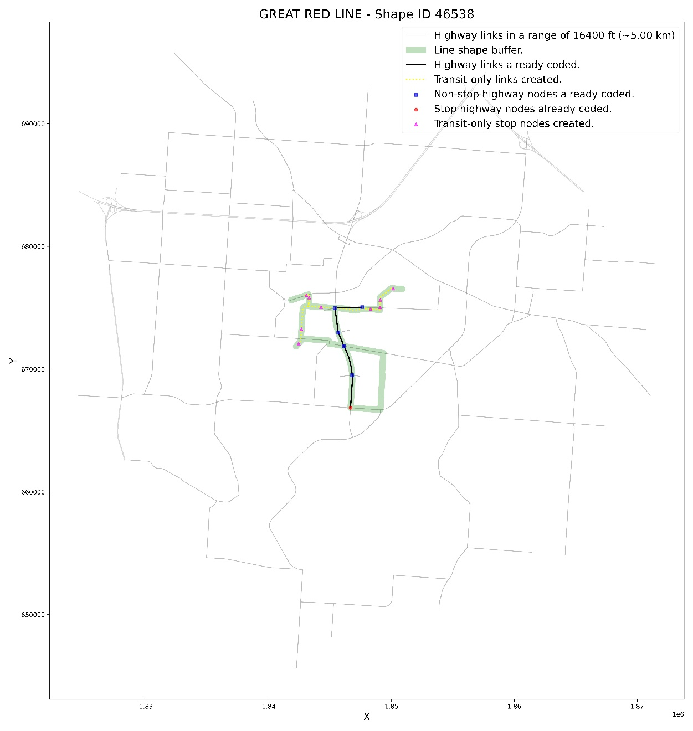
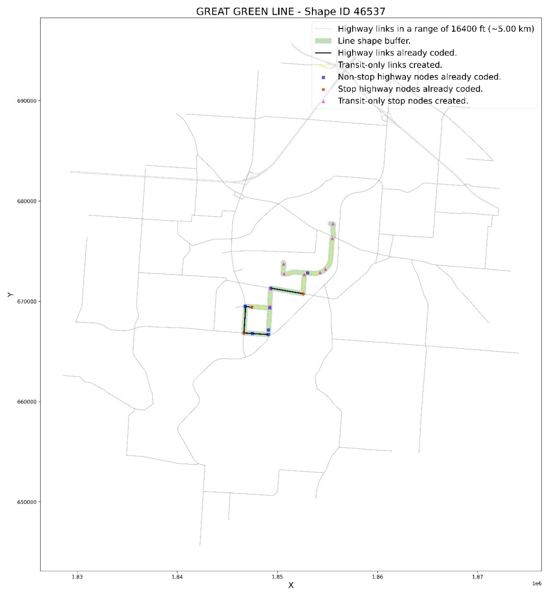
Outputs
Figure 21. COTA line Great Green with MORPC network.
Figure 22. COTA line Great Red with MORPC network.

Slide 24
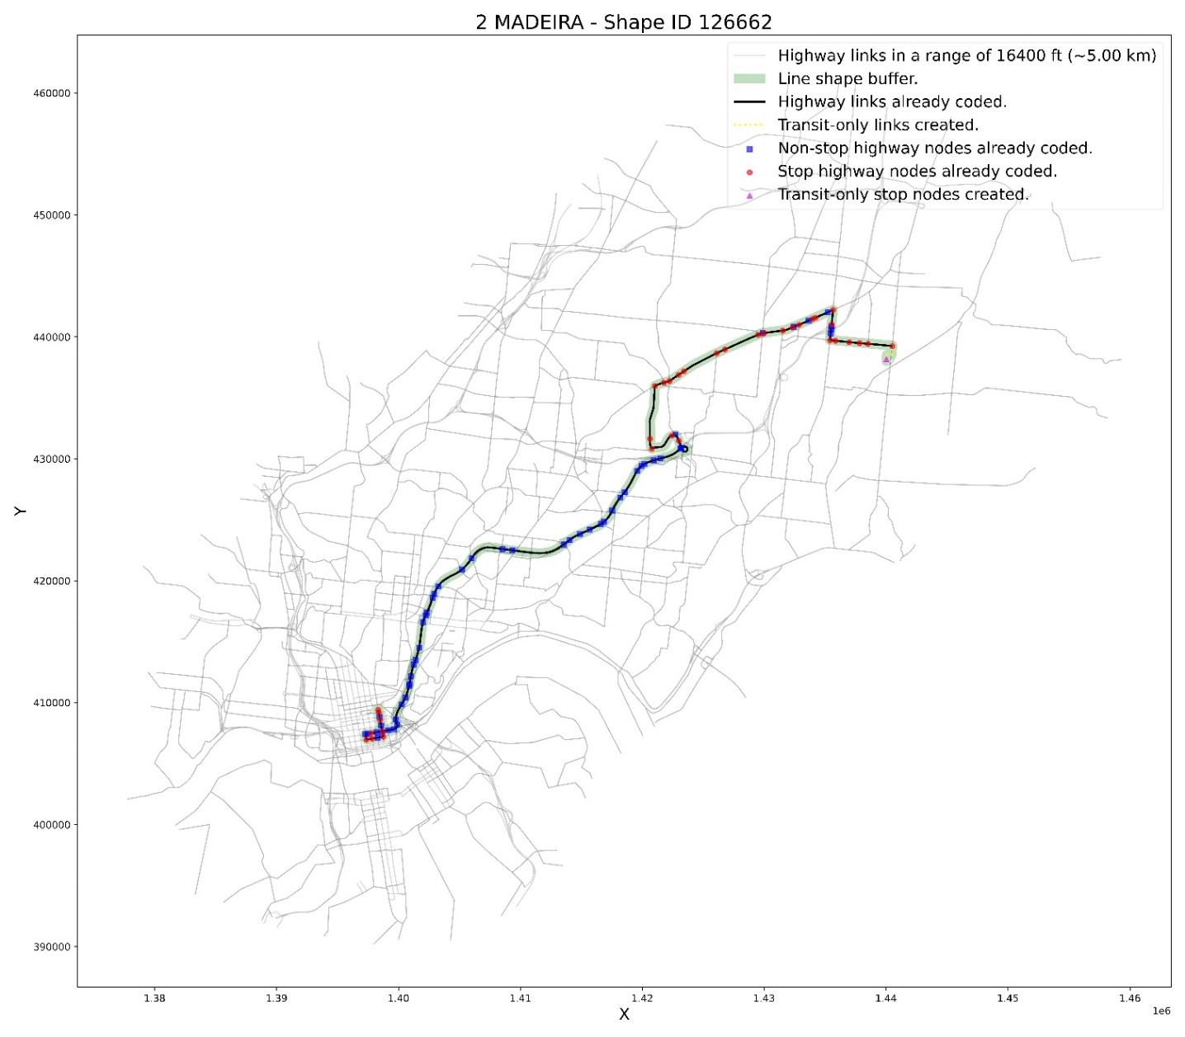
Outputs
Figure 23. GOMETRO/SORTA line 2 with statewide network.

Slide 25
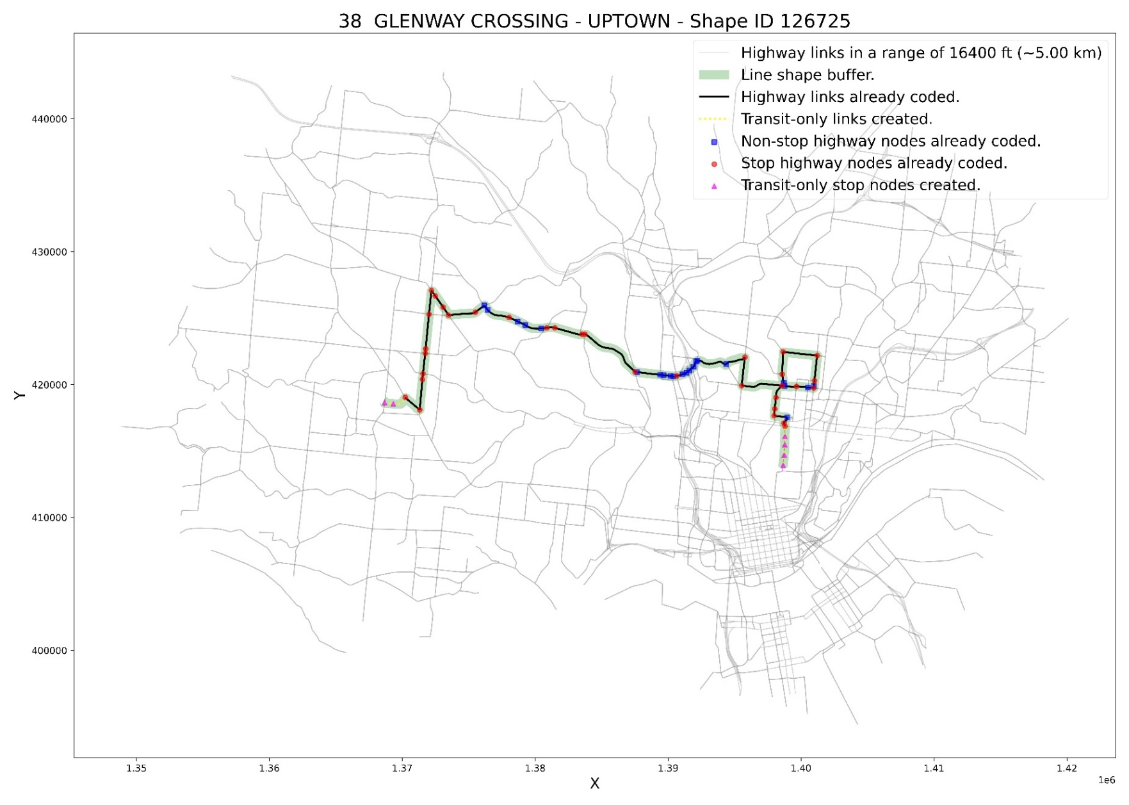
Outputs
Figure 24. GOMETRO/SORTA line 38 with statewide network.

Slide 26
Conclusions and Recommendations
The four main core functions of the Python-based tool are related to:
The bus line buffer.
The highway stops.
The shortest path that connects the highway stops.
The creation of transit-only elements (links and nodes).
The two most important inputs are the network “trueshape” and the “within_buffer”.
The tool does not perform well with bus lines that ride roads in both directions (e.g., circular bus lines).
The tool was only tested with bus lines, but it should work for any mode if the right network is provided.
Create indicators to assess the quality of the coded lines (e.g., % of transit-only elements, geometry analysis).
Revise the selection of highway stops.
Introduce an auto selection function for the “within_buffer”.
Adapt Google’s or Microsoft’s “Snap to Road” tools for this application.

Slide 27

DIEGO GALDINO, MSc.
Associate Engineer
Mid-Ohio Regional Planning Commission
dgaldino@morpc.org
111 Liberty Street, Suite 100
Columbus, OH 43215
GitHub: https://github.com/morpc/morpc-gtfs-to-public-transit-network

